Slide 1

Your Stock Siri
By: Hacker 5

Slide 2
Current Market Solution
- Example
Google Finance
Yahoo Finance
Market Watch
These solutions have numerous Datas…….
Datas and Datas!!!

Slide 3
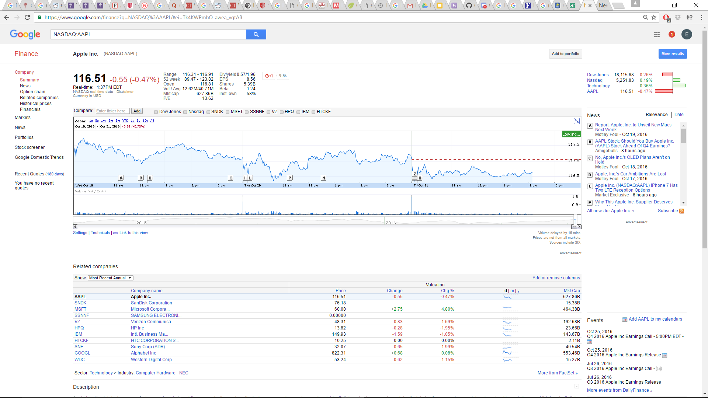

Slide 4
What Does It Do?
Allow the user to seamlessly search for stock name or ticker symbol for stats such as 30 days trend average, current stock price, previous day movement percentage and investability

Slide 5
Our Goal and Mission
We want to gather all the big data and simplify the data for our portfolio managers and investment specialist

Slide 6
Our Solution: How is it better?
Make decision in 5 mins
More efficient
Easy to read

Slide 7
Future Development
Can work like Siri (Using Speech Recognition) to display or echo out results
Display only important information to assist portfolio manager to make decisions(merger & acquisition,
Merger a, legal

Slide 8
Demo
Repos must be public

